Slide 1
Quantum Computing
Hands on with Qiskit

Slide 2
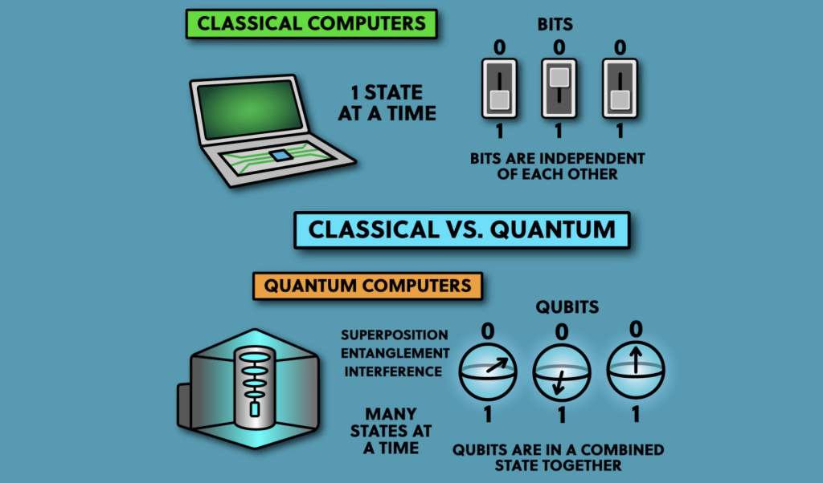
Classical Computers vs Quantum Computer

Slide 3
Binary
1 1 0 1 1 0 1
= 1 * 2 ^ 6 + 1 * 2 ^ 5 + 0 * 2 ^ 4 + 1 * 2^ 3 + 1 * 2 ^ 2 + 0 * 2 ^ 1 + 1 * 2 ^ 0
= 64 + 32 + 0 + 8 + 4 + 0 + 1
= 109

Slide 4
Hexadecimal
0 1 2 3 4 5 6 7 8 9 A B C D E F
10 11 12 13 14 15
A 4 F 6
=10 * 16 ^ 3 + 4 * 16 ^ 2 + 15 * 16 ^ 1 + 6 * 16 ^ 0
=40960 + 1024 + 240 + 6
=42230

Slide 5
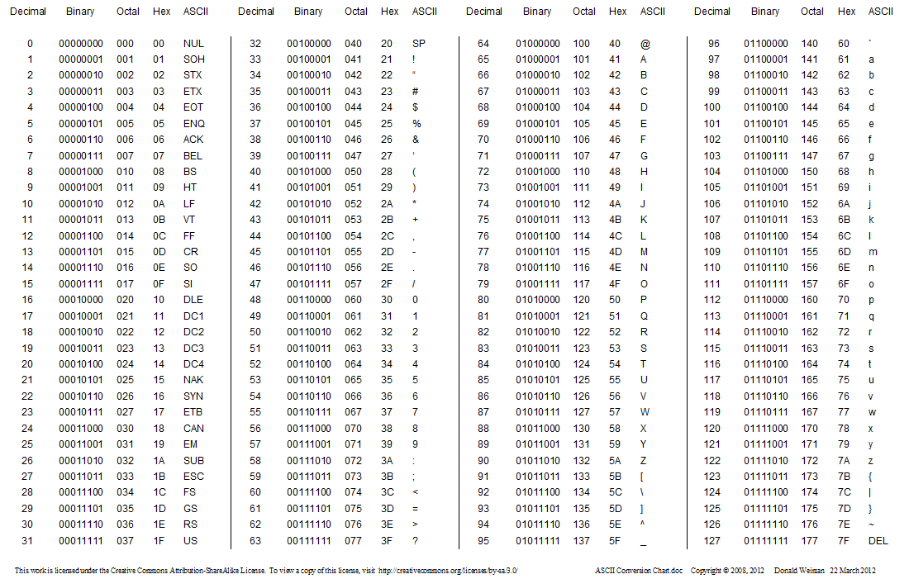
ASCII conversion Chart

Slide 6
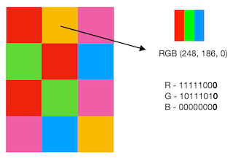
Pixel

Slide 7
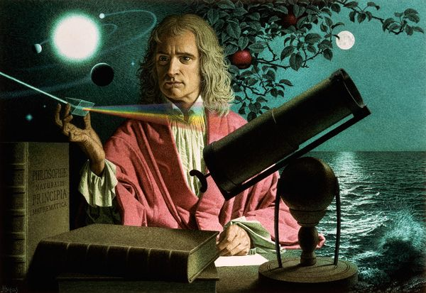
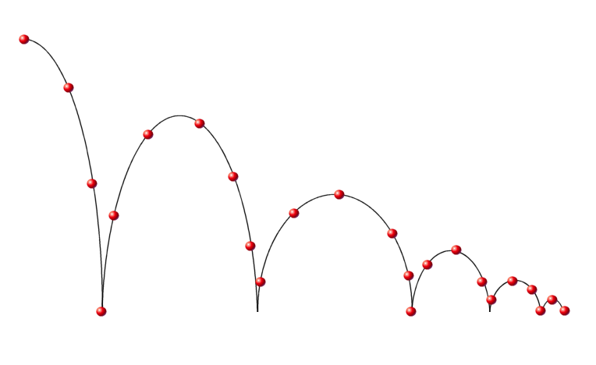
Classical computing (Newtonian Mechanics)
Classical mechanics provide extreme accurate results while dealing with movements of objects in normal scale
The classical theories are simple, but this branch of mechanics cannot be applied to extremely small particles moving at very high speed, as the results may be inaccurate

Slide 8
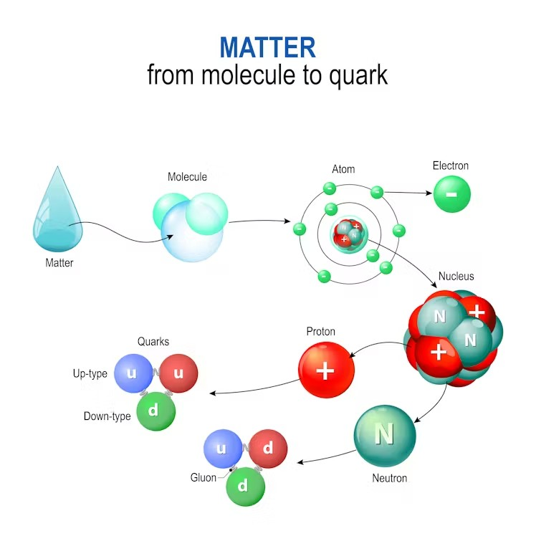
Quantum Mechanics
It is a fundamental theory in physics dealing with the behaviour of matter and energy on the scale of atoms and subatomic particles/waves.

Slide 9
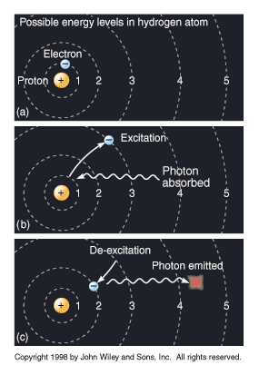
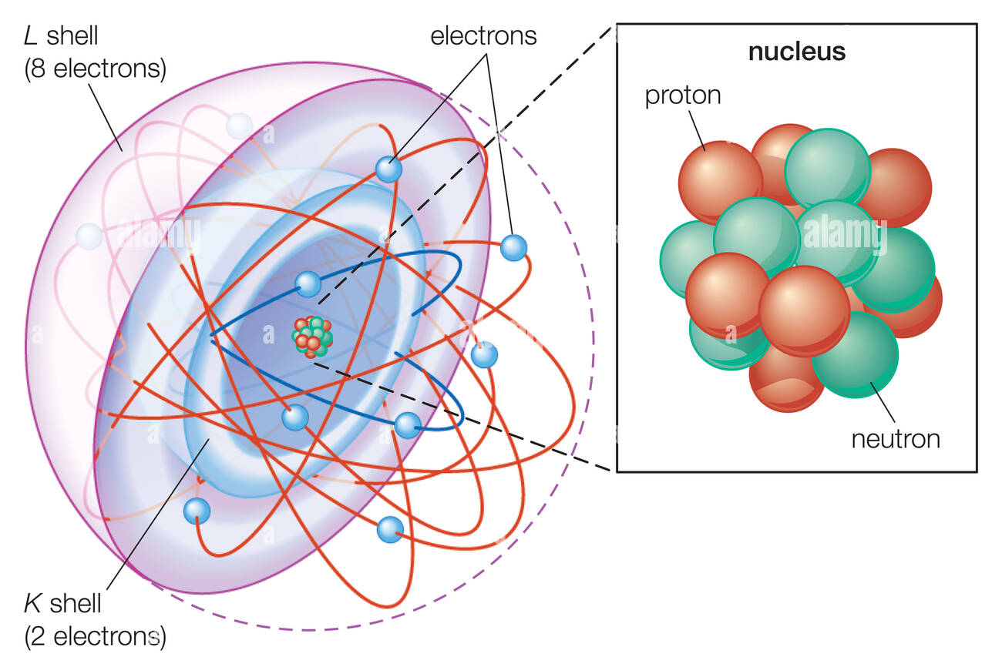
Single Quantum of Energy
Quantum is a discrete packet of energy.
One photon carries exactly one quantum of energy.

Slide 10
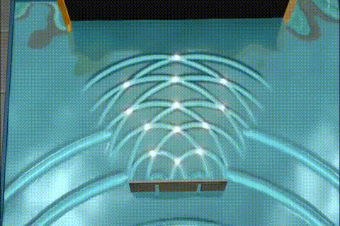
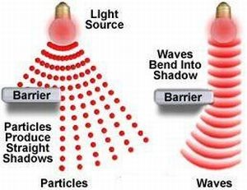
Wave Duality
The dual nature of light means that light can exist as both a particle and a wave.

Slide 11
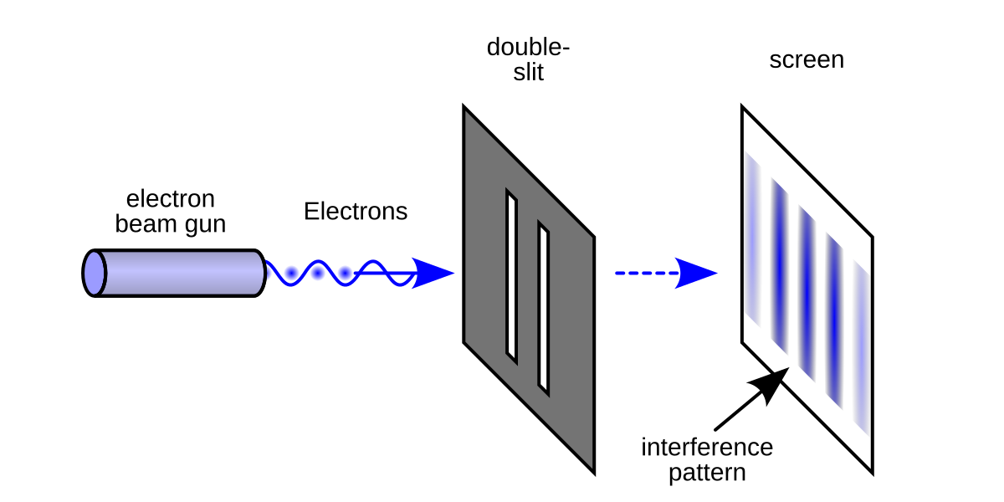
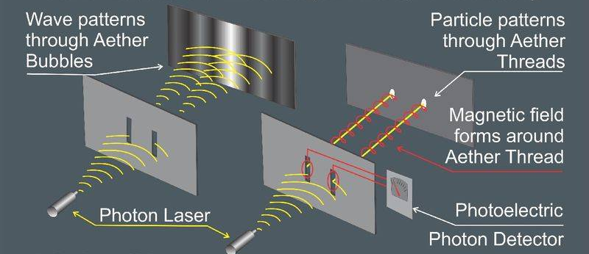
Double Slit
A measurement barrier

Slide 12
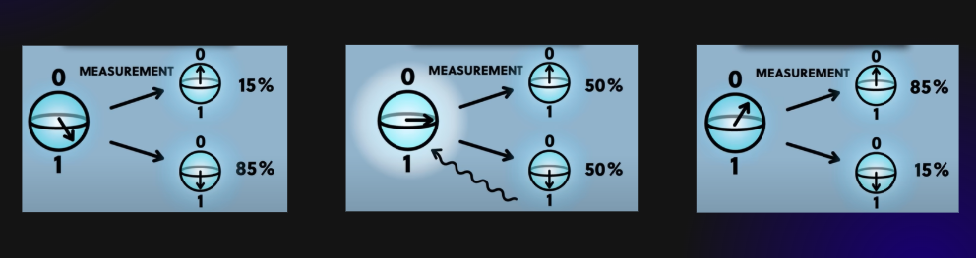
Superposition
Superposition is a property of individual qubits, allowing them to be in multiple states at once.

Slide 13
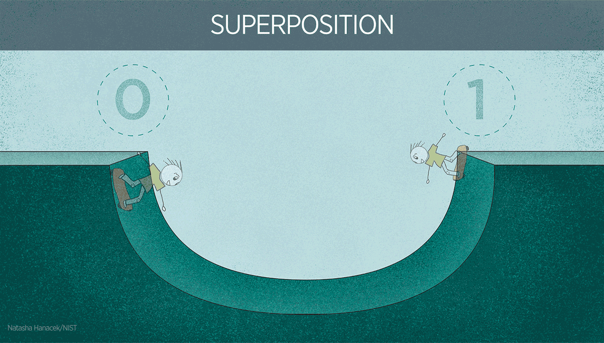
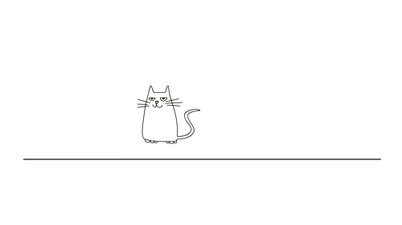
Superposition- Schrödinger's cat
Superposition is a property of individual qubits, allowing them to be in multiple states at once.

Slide 14
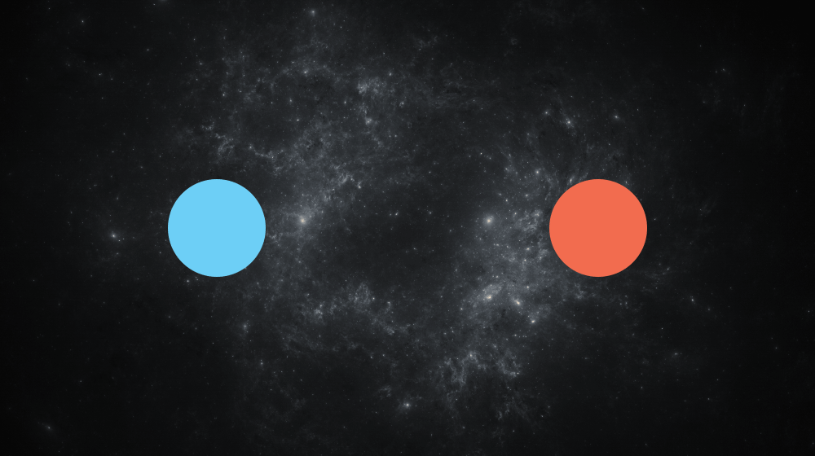
Quantum Entanglement
Quantum entanglement is when two or more particles become linked so that the state of one instantly affects the state of the other, no matter how far apart they are.

Slide 15
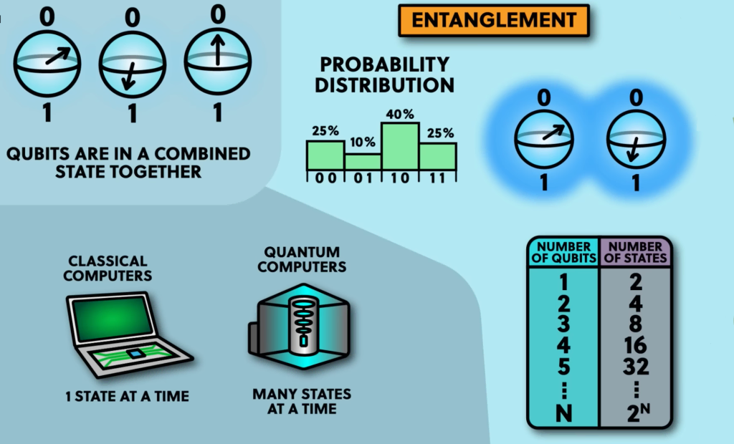
Entanglement
Feature | Description
Non-locality | Measuring one particle’s state instantly determines the state of its entangled partner.
No Classical Analog | Entanglement is purely quantum, it cannot be explained by classical physics.
Shared State | The entire system is described by a single wavefunction, the subsystems don’t have independent states.
Instant Correlation | Entangled particles always show correlated outcomes, even when separated by large distances.
Bell States | Quantum entanglement violates classical assumptions like locality and realism
Quantum entanglement is when two or more particles become linked so that the state of one instantly affects the state of the other, no matter how far apart they are.

Slide 16
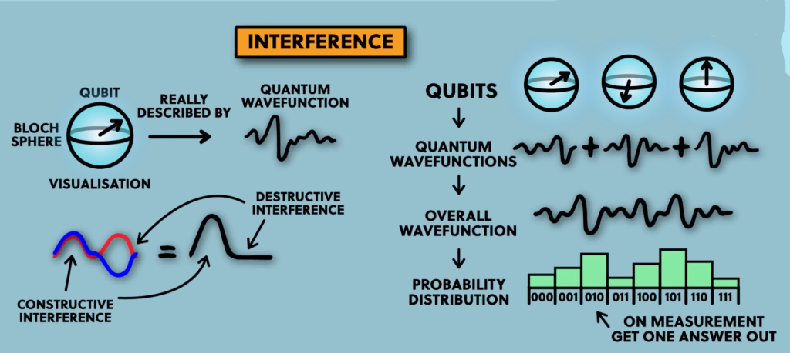
Interference
Feature | Description
Superposition | Interference happens only when particles are in superposition states.
Probabilistic | It affects probability amplitudes, not final values directly.
Constructive | Amplitudes reinforce , increases likelihood of a result.
Destructive | Amplitudes cancel, suppresses certain outcomes.
Quantum interference is a fundamental phenomenon in quantum mechanics where probability amplitudes, add or cancel each other out, affecting the outcome of quantum measurements.

Slide 17

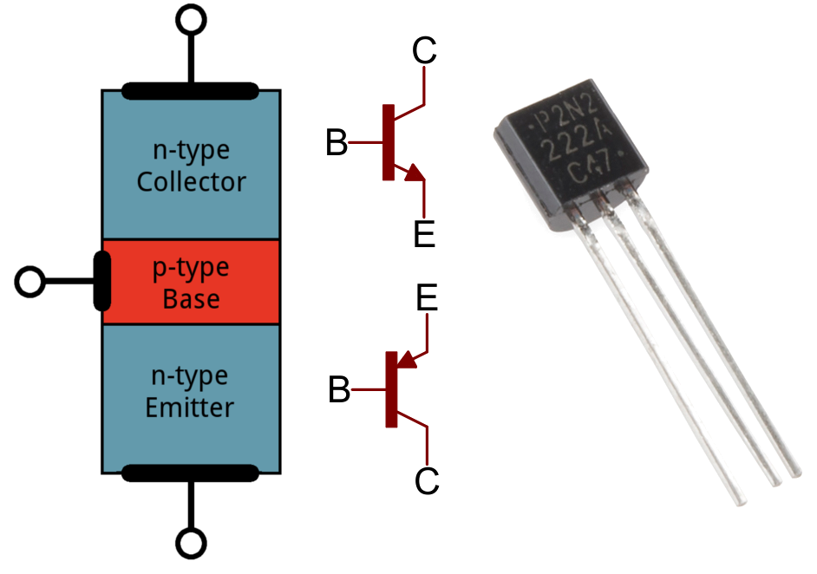
Quantum Tunnelling
It is quantum mechanical phenomenon where a sub atomic particle disappears from one side of a potential barrier and appears on the other side without any current.

Slide 18
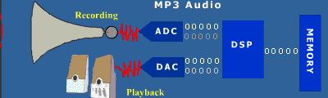
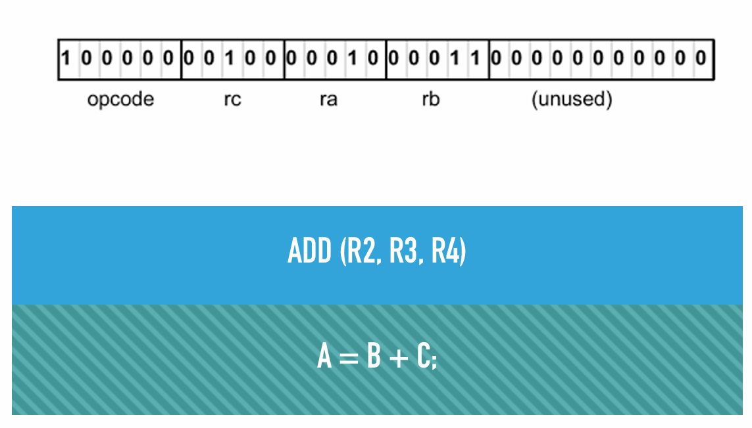
Bit
Machine Learning
Assembly
High level language

Slide 19
Quantum overview
Field | Description | Examples / Tools
Quantum Algorithms | Designs efficient QC algorithms | Shor’s algorithm, Grover’s algorithm
Quantum Information Theory | Studies storage, processing, and transfer of quantum information | Qubits, entropy, entanglement, error correction
Quantum Hardware / Devices | Builds physical quantum computers using various technologies | Superconducting qubits, trapped ions, photonics
Quantum Error Correction | Protects quantum data from noise and decoherence | Shor code, surface code, stabilizer codes
Quantum Programming & Software | Develops tools and languages for programming quantum systems | Qiskit (IBM), Cirq (Google), Q# (Microsoft)
Quantum Communication | Enables secure quantum data transmission | Quantum teleportation, QKD
Quantum Cryptography | Uses quantum Principles for Secure encryptions | BB84 protocol, post quantum cryptography
Quantum Simulation | Simulates quantum systems difficult for classical computers | Molecular simulation, quantum chemistry
Quantum Machine Learning | Merges quantum computing with ML techniques | Variational classifiers, quantum neural networks
Quantum Control & Calibration | Optimizes gate fidelity and operation in real devices | gate error suppression
Theoretical Quantum Physics | Provides mathematical foundation for quantum computing | Decoherence theory, entanglement entropy

Slide 20
Quantum Algorithms
Quantum Algorithm | Purpose | Example
Shor’s Algorithm | Integer factorization, exponential speedup over classical | Breaking RSA: factoring 15 → 3 × 5
Grover’s Algorithm | Unstructured search, quadratic speedup | Finding a name in an unsorted phonebook - O(√n)
Quantum Fourier Transform (QFT) | Frequency analysis, used in many quantum algorithms | Shor’s algorithm, Quantum Phase Estimation
Quantum Phase Estimation (QPE) | Estimate eigenvalues of a unitary operator | Finding energy levels of quantum systems
Variational Quantum Eigensolver (VQE) | Hybrid approach for finding ground-state energy of molecules | Estimating H₂ molecule energy
Quantum Approximate Optimization Algorithm (QAOA) | Solving combinatorial optimization problems | Max-Cut problem in graphs
Deutsch-Jozsa Algorithm | Determines if a function is constant or balanced with a single query | Proving exponential advantage over classical
Simon’s Algorithm | Solves a specific hidden period problem exponentially faster than classical | Foundation for Shor’s algorithm
Amplitude Estimation | Estimates the probability of measuring a certain quantum state more efficiently | Used in finance, Monte Carlo simulations
Quantum Walk Algorithms | Solving problems via quantum analog of random walks | Element distinctness, graph traversal
Harrow-Hassidim-Lloyd (HHL) | Solving systems of linear equations exponentially faster than classical methods | Solving Ax = b in quantum machine learning

Slide 21
Quantum Hardware
Feature | Superconducting Qubits | Trapped Ions | Photonic Qubits
Qubit Type | Electrical circuits (Josephson junctions) | Individual ions suspended in traps | Particles of light (photons)
Operating Temp | ~15 millikelvin (ultra-cold) | Room temp (with vacuum) | Room temperature
Gate Speed | Very fast (nanoseconds) | Slower (microseconds) | Very fast (picoseconds), but gates are probabilistic
Gate Fidelity | High (improving rapidly) | Extremely high | Lower (currently improving)
Scalability | Good (2D chip integration) | Medium (scaling traps is complex) | Promising (optical chips, multiplexing)
Best Use Case | General-purpose quantum computing | High-precision quantum logic | Quantum communication, early computation
Major Companies | IBM, Google, Intel | IonQ, Quantinuum | Xanadu, PsiQuantum, ORCA Computing
Challenges | Requires dilution refrigerators | Complex laser systems, bulky setup | Photon loss, hard to store/interact photons
Maturity Level | Most mature and commercially deployed | Mature, especially for small systems | Emerging and rapidly evolving
Notes:
Trapped Ions - Companies like IonQ and Quantinuum leverage this technology
Superconducting Qubits - used by industry leaders like IBM, Google, and China’s Zuchongzhi 3.0
Photonic Qubits - Photons don’t easily interact with each other, making it hard to perform 2-qubit gates , Xanadu, PsiQuantum, ORCA Computing

Slide 22
Quantum Errors
Quantum Error | Description
Decoherence | Loss of quantum behavior (like superposition or entanglement) due to interaction with the environment.
Dephasing (Phase Damping) | Loss of phase information between quantum states, destroys interference but not energy levels.
Amplitude Damping | Energy loss from excited state
Bit-flip Error | A qubit flips from ∣0⟩↔∣1⟩
Phase-flip Error | Flips the phase of a qubit, changing superpositions without affecting probabilities.
Measurement Error | Wrong result is read out due to noise or imperfections in the measurement process.
Gate Error | Imperfect quantum gate application due to control inaccuracies or hardware limitations.

Slide 23
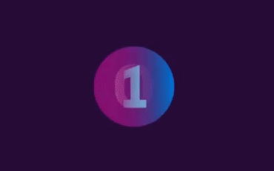
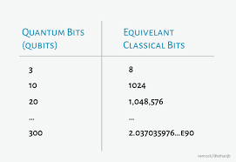
Qubit
It is a basic unit of quantum information.
It can be in 0,1 or superposition of 0 and 1
When they are measured they can be either 0 or 1
There are 2^{n} possible states.

Slide 24
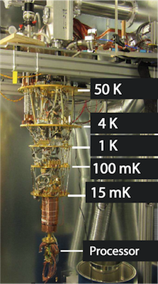
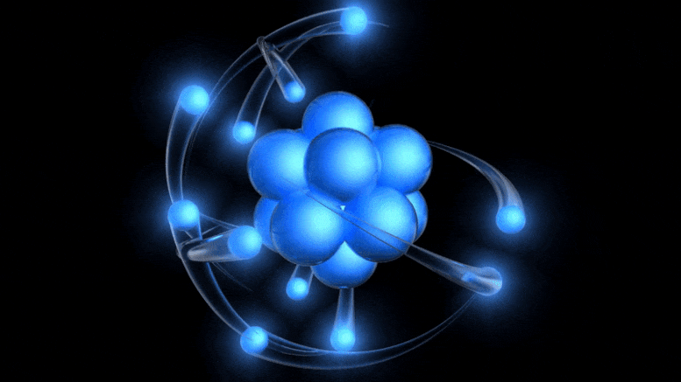
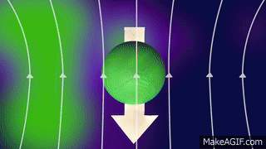
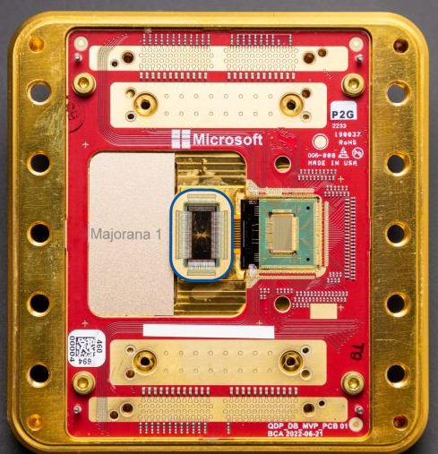
Creating a Quantum Qubit

Slide 25
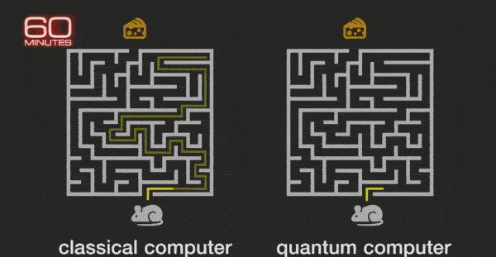
Qubit vs Bit
Classical bit can do only single calculation at a time.
Qubit can exist simultaneously in multiple states.
Adv of qubit- parallel processing.

Slide 26
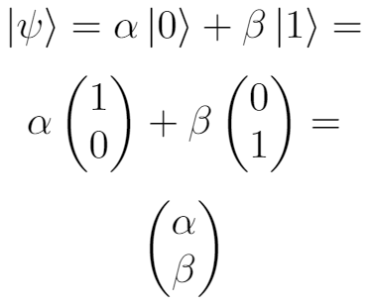
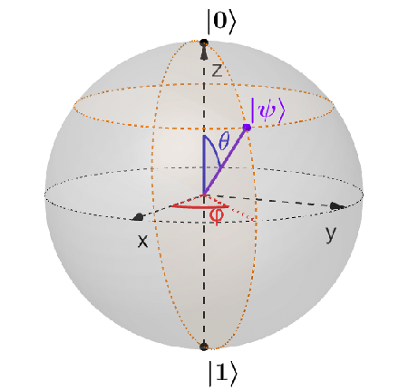
Quantum Qubit State Representation
Qubit needs two more variable to denote its value based on its position in the Bloch sphere.
Bra-Ket notation < | > is used to describe the value of a qubit as a vector in sphere.

Slide 27
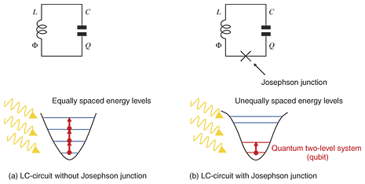
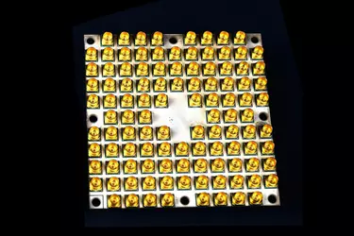
Superconducting Qubit Generation
Natural qubits are isotopes like ¹³C and ²⁹Si
“Non linear LC resonator” oscillation circuit forms man made qubit.
A Josephson Junction(X) is used to restrict the dynamics to two levels.

Slide 28
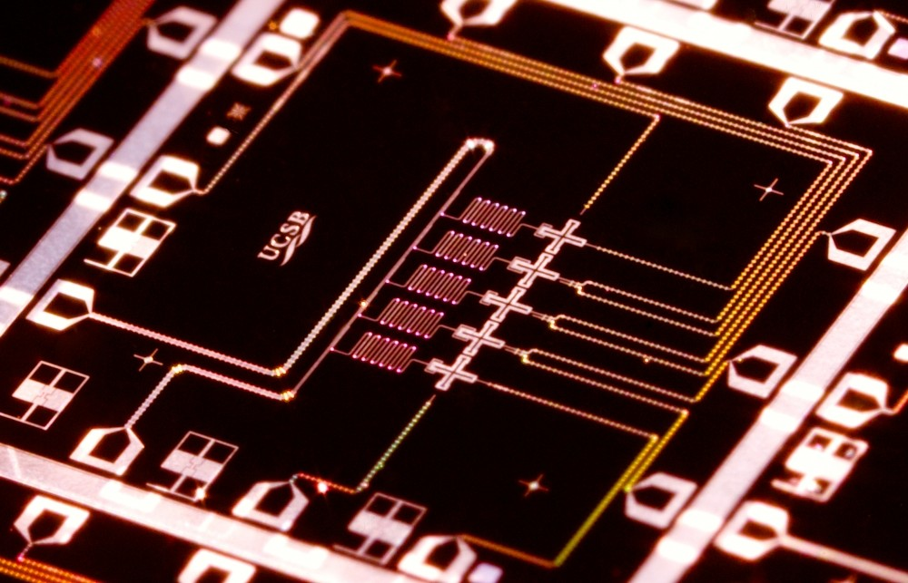
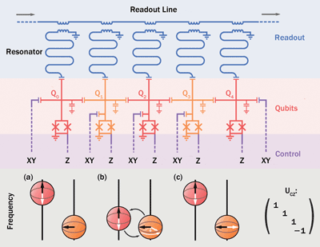
Quantum Bit Readout

Slide 29

Matrix – Tensor Product
ax
ay
bx
by
a
b
x
y
2
5
7
6
15
21
1
3
2
5
7

Slide 30
Identity Matrix
1 0
0 1
Identity Matrix (I)
XI = X
0 2
3 1
1 0
0 1
0 2
3 1
A⁻¹ = 1/A
AA⁻¹ = I or A⁻¹A = I

Slide 31
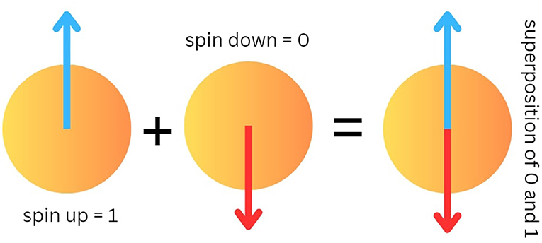
Bra-ket Notation
Bra-ket < A | E >
|1> spin down
|0> spin up
0
1
1
0

Slide 32
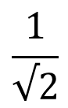
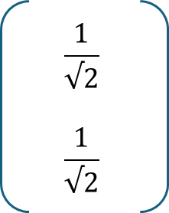
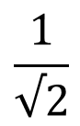
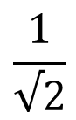
Bra-ket Notation in Superposition
$$\frac{1}{√2}$$
$$\frac{1}{√2}$$
1
0
0
1
$$\frac{1}{√2}$$
$$\frac{1}{√2}$$
$$\frac{1}{√2}$$
( |0> + |1> )
Total probability of a qubit in superposition must always equal 1

Slide 33
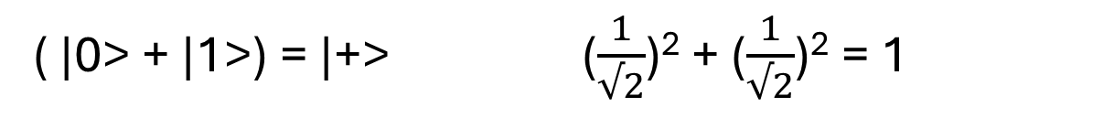
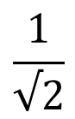
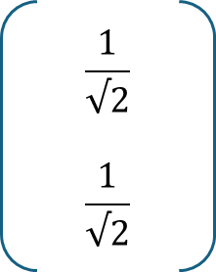
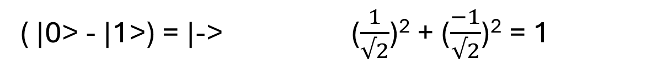
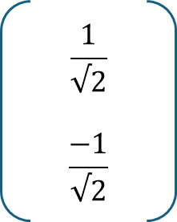
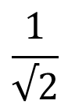
Bra-ket Notation in Superposition-Entanglement
x
y
0
1
1
0
|x|² + |y|² = 1
|1> 0² + 1² = 1
|0> 1² + 0² = 1
$$\frac{1}{√2}$$
$$\frac{1}{√2}$$
$$\frac{1}{√2}$$
( |0> + |1>) = |+> ($\frac{1}{√2}$)² + ($\frac{1}{√2}$)² = 1
$$\frac{1}{√2}$$
$$\frac{−1}{√2}$$
$$\frac{1}{√2}$$
( |0> - |1>) = |-> ($\frac{1}{√2}$)² + ($\frac{−1}{√2}$)² = 1

Slide 34
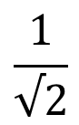
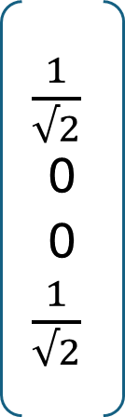
Multi Qubit – Superposition and Entanglement
$\frac{1}{√2}$0
0 $\frac{1}{√2}$
1
0
0
0
0
1
0
0
0
0
1
0
0
0
0
1
00
01
10
11
$$\frac{1}{√2}$$
( |00> + |11> )
|00> |01> |10> |11>

Slide 35
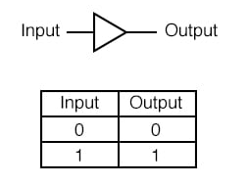
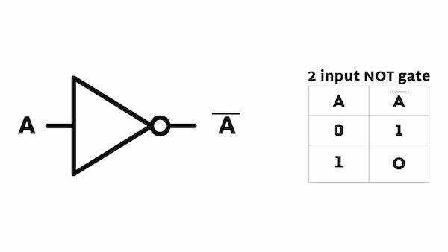
Classical Gates
Buffer Gate
NOT Gate

Slide 36
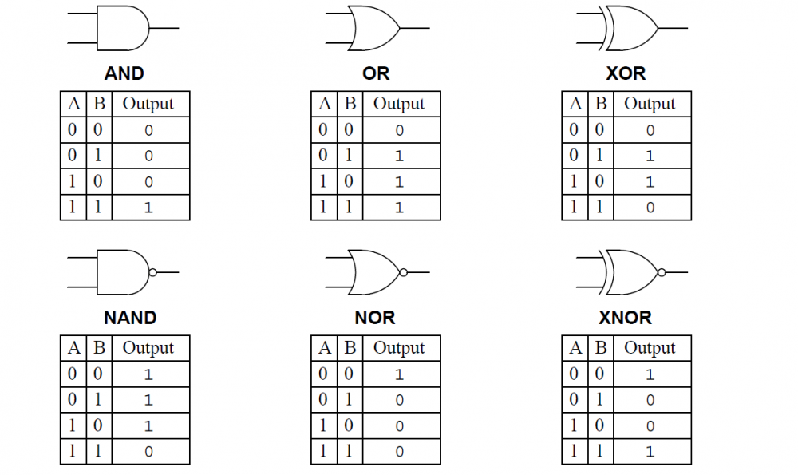
Classical Gates

Slide 37
Quantum Gates
Gate | Effect on Amplitude / Phase
X | Flips amplitudes |0> - |>
Z | Adds a phase of π (i.e., -1)
Y | Flips and adds a phase (combination of X and Z)
H (Hadamard) | Creates superposition, redistributes amplitudes, adds ± phases
T | Adds a phase of π/4 (45°) to
S | Adds a phase of π/2 (90°) to
RX/RY/RZ | Rotates the qubit on the Bloch sphere, changing amplitude and/or phase

Slide 38


Quantum Gates – Pauli X

Slide 39

Quantum Gates – Pauli Y
0 -i
i 0
0
1
-i
0
Y|1>
-|i>
0 -i
i 0
1
0
0
i
Y|0>
|i>

Slide 40

Quantum Gates – Pauli Z
1 0
0 1
0
1
0
-1
Z|1>
-|1>
1 0
0 1
1
0
1
0
Z|0>
|0>

Slide 41



Quantum Gates – Hadamard Gate
= |+>
= |->

Slide 42


Quantum Gates – CNOT Gate Matrix
Input (t,c) output(t,c)
Performs X gate on the second qubit (target) if the state of the first qubit(control) is |1>

Slide 43




Quantum Gates – Hadamard and CNOT
1
0
1
0
q2 q1 = |0+>
Hadamard * |0> = |+>
(q1) (q1)
CNOT * |0+> = $\frac{1}{√2}$( |00> + |11>)

Slide 44

Quantum Gates – CNOT Gate Matrix
cx(a,b) without superposition
0
0
1
1
q0 = 1
q1 = (0,1) flips (1,0)
(a)
0
0
1
1
0
1
1
0
(b)
0
1
0
1
cx(a,b) with superposition
0.5
-0.5
-0.5
0.5
q0 = (0.5,-0.5) flips (-0.5,0.5)
q1 = -0.5
(a)
0.5
0.5
-0.5
-0.5
0.5
-0.5
0.5
-0.5
(b)
0.5
-0.5
0.5
-0.5

Slide 45

Quantum Gates – Controlled Z Gate
Just like CNOT applies X gate to target where control is 1,
CZ gate applies Z gate to ‘target’ when the ‘control’ is 1.
Input (t,c) output(t,c)
00 00
01 01
10 10
11 -11

Slide 46

Multi Qubit
A single bit has 2 possible states 0 and 1.
A qubit has 2 possible states |0> and |1> and complex amplitude.
Two bits have 4 possible states 00 01 10 11
Two qubits requires four complex amplitudes to represent its states.

Slide 47


Toffoli gate (Controlled-Controlled-NOT)
A three qubit gate with 2 controls and 1 target.
It performs an X gate on the target only is both controls are in |1>

Slide 48
Deutsch-Jozsa Problem
Consider a binary function f(x) that takes one bit, 0 or 1 as input and outputs either 0 or 1
There are 4 possible combinations.
In 2 cases, the function is balanced (i.e. output is dependent)
In other 2 cases, the function is constant (i.e. output is independent)
Balanced: Constant:
f(0) = 0, f(1) = 1 f(0) = 0, f(1) = 0
f(0) = 1, f(1) = 0 f(0) = 1, f(1) = 1
This can be solved only by evaluating the function twice in classical computer.
But a quantum computer can solve it by evaluating it only once using superposition.

Slide 49

Deutsch-Jozsa Problem
For ‘n’ bit input, we need at least 2^{n-1} +1 evaluations.
Eg: 32 bit problem will take 2³²⁻¹ +1 = 2,14,74,83,649 evaluations.
In quantum computer, this problem can be solved with 100% confidence after only one call to the function f(x) [for a single bit]

Slide 50

Deutsch-Jozsa Problem
Step1: Initialize qubits |0> and |1>
Step2: Place the qubits into superposition
Step3: Pass the inputs into the oracle function
Step4: apply transformation to group and measure output
|0>
H
O_{f}
H
|0>
X
H

Slide 51

Bernstein Vazirani Algorithm
Guess 2⁷
Classical computer 7 trials
Quantum computer 1 trial

Slide 52
Grover’s Algorithm
Guess 2⁷
Classical computer 7 trials
Quantum computer 1 trial

